Slide 1
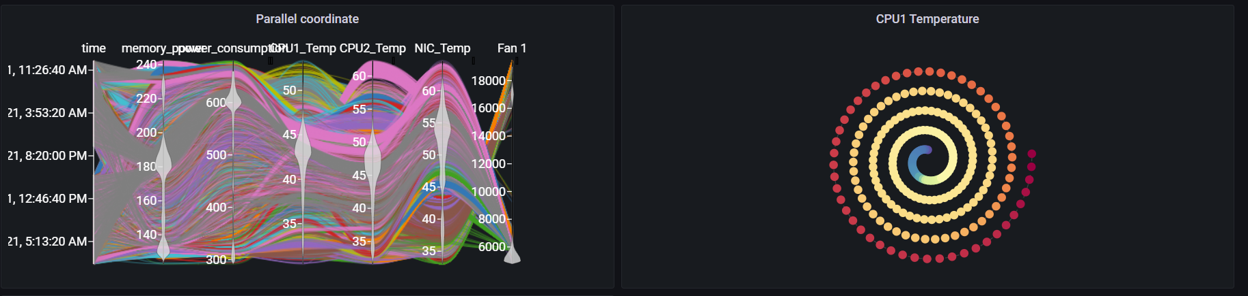
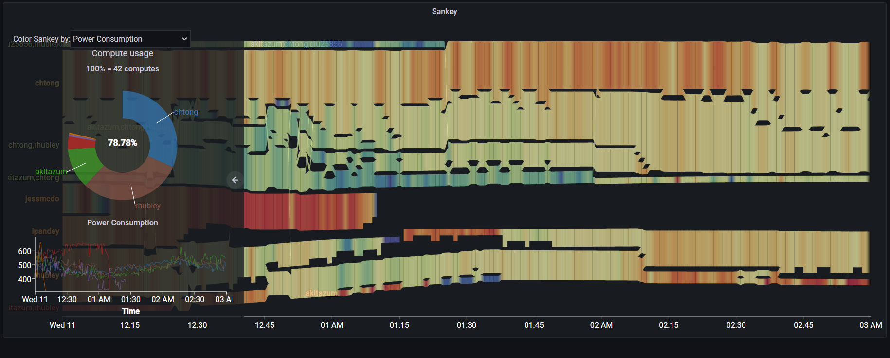
Grafana Plugin
Weekly report

Slide 2
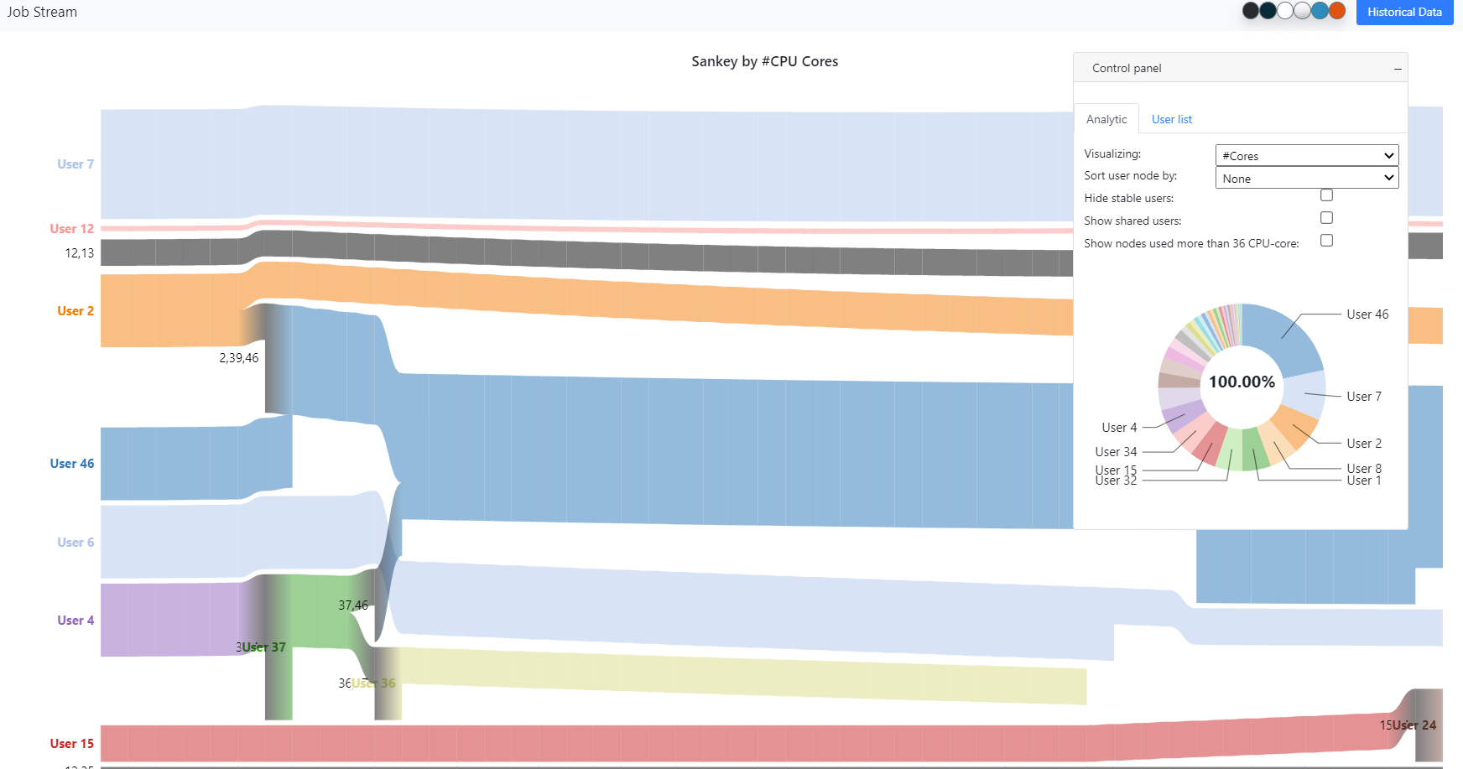
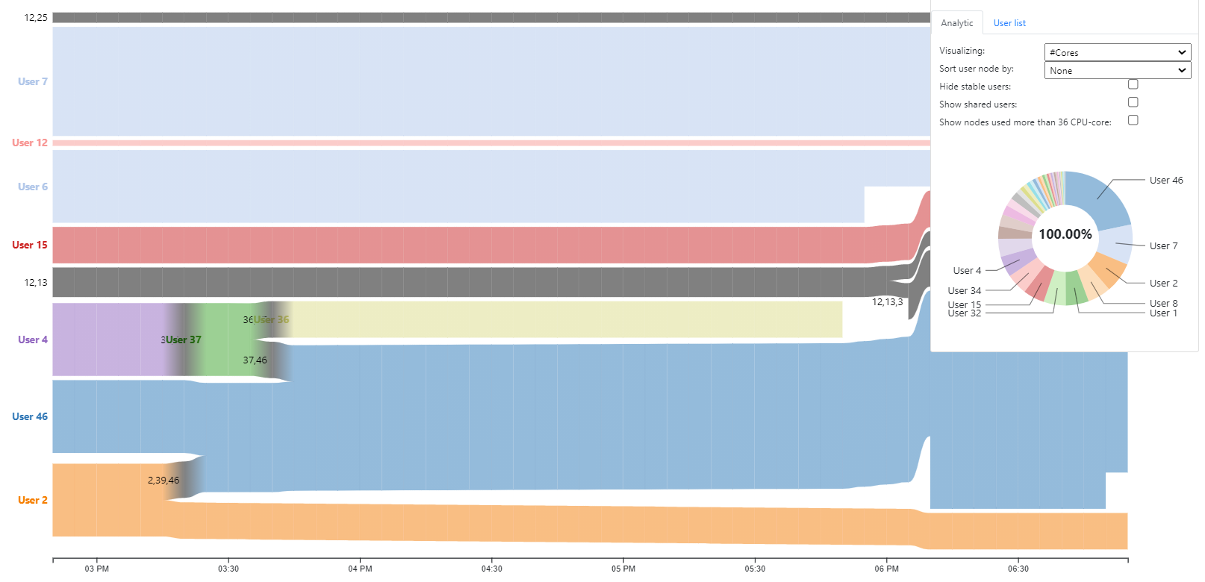
Sankey

Slide 3
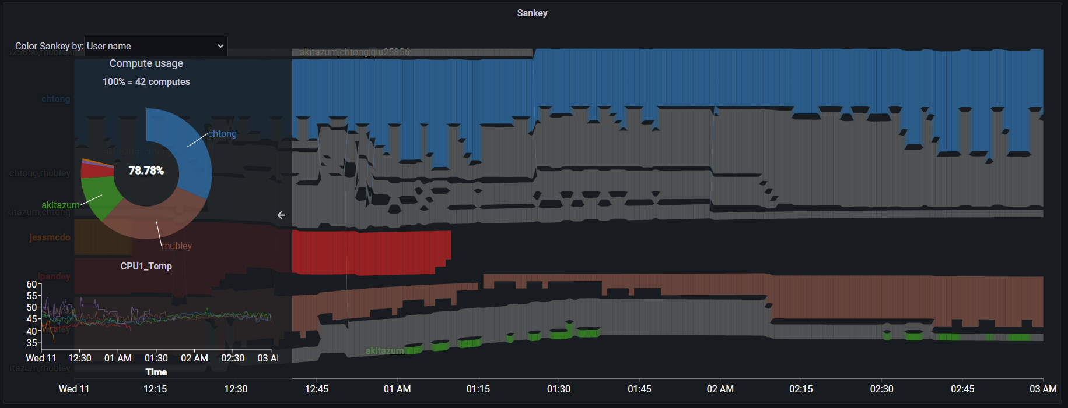
Previous result

Slide 4
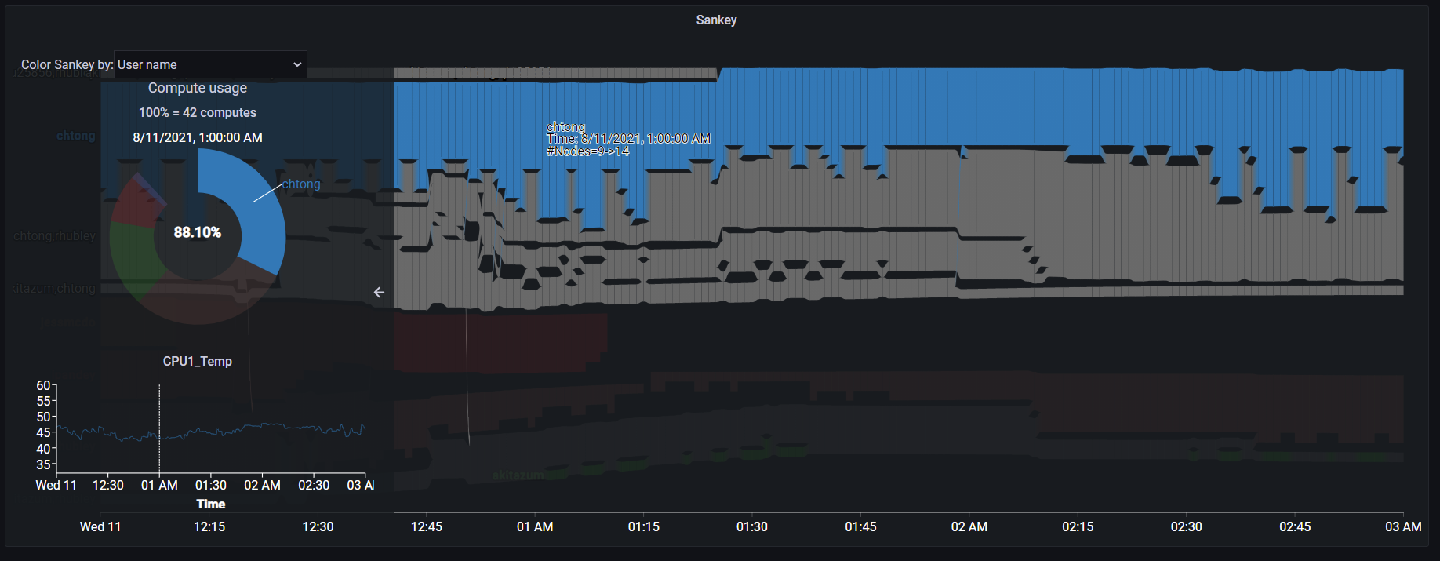
Previous result

Slide 5
Previous result

Slide 6
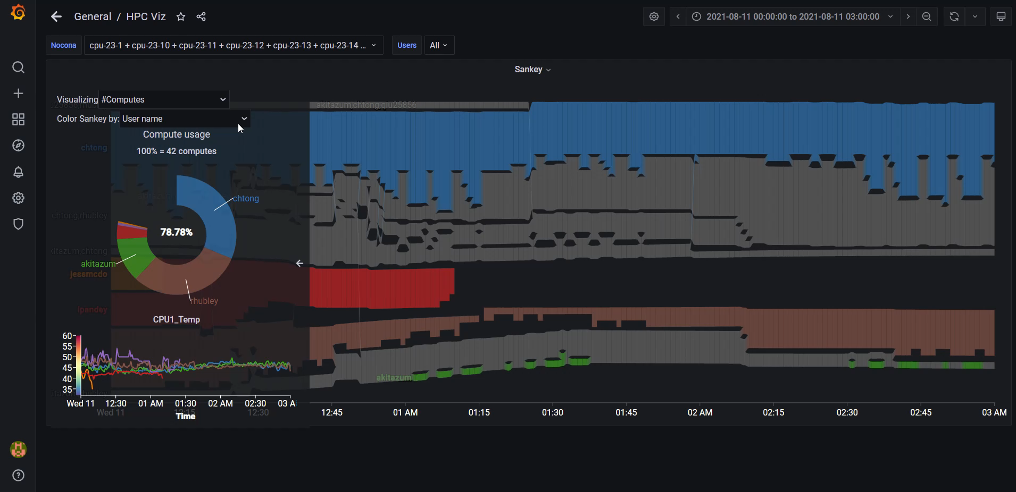
Current result

Slide 7
Current features
Sankey by #cores/computes
Zoom/Pan
Summary pie chart for Core/Compute usage
Line chart for particular metric
Color stream by metric
Embeded job info on stream

